Slide 1
Computer network session 10
APPLICATION LAYER
Santoso Budijono

Slide 2
Learning outcomes
LO 1: Describe basic structures of network
LO 2: Explain basic concepts of network

Slide 3
topics
ELECTRONIC MAIL – SMTP
WEB - HTTP

Slide 4
EMAIL - SMTP
Most heavily used application on any network
Simple Mail Transfer Protocol (SMTP)
  TCP/IP
  Delivery of simple text messages
Multi-purpose Internet Mail Extension (MIME)
  Delivery of other types of data
  Voice, images, video clips

Slide 5
EMAIL - SMTP
PROTOCOL SMTP
Not concerned with format of messages or data
SMTP uses info written on envelope of mail
  Message header
Does not look at contents
  Message body
Except:
  Standardize message character set to 7 bit ASCII
  Add log info to start of message
    Shows path taken

Slide 6
EMAIL
BASIC OPERATION
Mail created by user agent program (mail client)
  Message consists of:
    Header containing recipient’s address and other info
    Body containing user data
Messages queued and sent as input to SMTP sender program
  Typically, a server process (daemon on UNIX)

Slide 7
EMAIL
SMTP SENDER - RECEIVER
SENDER
Takes message from queue
Transmits to proper destination host Via SMTP transaction Over one or more TCP connections to port 25
Host may have multiple senders active
Host should be able to create receivers on demand
When delivery complete, sender deletes destination from list for that message
When all destinations processed, message is deleted
RECEIVER
Accepts arriving message
Places in user mailbox or copies to outgoing queue for forwarding
Receiver must:
  Verify local mail destinations
  Deal with errors
Sender responsible for message until receiver confirm complete transfer
  Indicates mail has arrived at host, not user

Slide 8
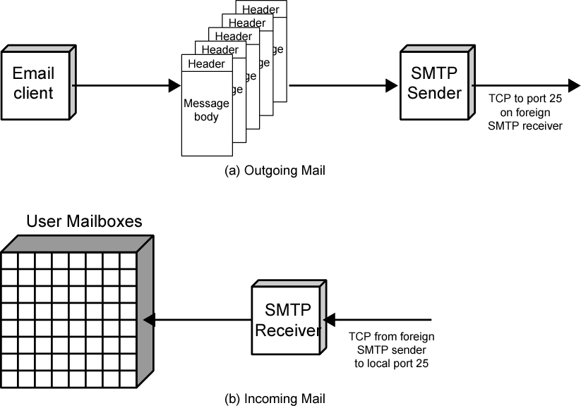
EMAIL
MAIL FLOW

Slide 9
WEB - HTTP
Transaction oriented client/server protocol
Usually between Web browser (clinet) and Web server
Uses TCP connections
Stateless
  Each transaction treated independently
  Each new TCP connection for each transaction
  Terminate connection when transaction complete

Slide 10
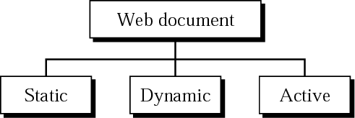
WEB - HTTP
WEB DOCUMENT

Slide 11
WEB - HTTP
Static web
These documents have fixed content that doesn't change unless manually updated by web administrator.
They are stored on the server and each request for a static document returns the same content
Examples : Basic web page like https://detik.com , https://binusmaya.binus.ac.id

Slide 12
Web - http
Dynamic document
These web document are generated in real-time by the server in response to a request.
The content can vary based on user interactions or other factors, such as current data from a database. Web server must be process the request first, get data from database and send to user.
Examples : Binusmaya website after login. Https://binusmaya.binus.ac.id – after login

Slide 13
Web - http
Active document
These document contain programs that run on the client's browser, allowing for interactive and continuously updating content.
Kind of application can be :
  Java Applets: Small applications written in Java that run within a web browser, providing interactive features like games or complex visualizations
  JavaScript : Programs written in JavaScript that run directly in the browser, enabling dynamic content updates, animations, and interactive form
Examples : google docs - allows multiple users to edit documents simultaneously, with changes appearing in real-time.

Slide 14
excercise
If you login to access study material at binusmaya, please explain in detail step by step type of web document applied on this web process?

Slide 15
REFERENCE
Forouzan, B. A. (2021). Data Communications and Networking with TCP/IP Protocol Suite. 6th Ed. New York: McGraw-Hill. ISBN: 978-1-26-436335-3. Chapter 10.

Slide 16
Thank you
December 2024

